Slide 1
ITSC 200 – Network Protocols and Security
Windows

Slide 2
Today’s Objectives
To learn Windows NTFS, SMB, and share permissions

Slide 3
Windows File System
Windows has two types of directory permissions :
NTFS file and directory permissions
Share-level permissions
NTFS permissions are always applied regardless of how the file system is accessed.
Share permissions are only applied if the file system is accessed remotely using SMB (Server Message Block).

Slide 4
Windows NTFS
Window’s native file system is NTFS.
Although the older FAT file system is supported, NTFS must be used to access more advanced features of Windows.
It is important to remember that, like many file systems, the file and directory attributes and security are stored with the file system itself, not the operating system.

Slide 5
Windows NTFS
The permission structure of NTFS is more complex than the UNIX/Linux file system permissions.
Broad concepts for NTFS are :
By default, file permissions are inherited from parent directories, but this behavior can be changed.
Explicit permissions take precedence over implicit permissions.
Explicit Deny trumps everything else.
Explict Allow trumps anything except an explicit deny.

Slide 6
Windows NTFS
NTFS has the ability to assign “creator/owner” permissions in a directory used by multiple users.
When explicit permissions are set on a directory, they can be forced down the directory tree replacing existing permissions, or they can be assigned to the single directory.
When explicit permissions are set on a directory, they can be forced on all of the files in the directory, replacing existing file permissions.

Slide 7
Windows NTFS
Inherited NTFS permissions are cumulative, and explicit permissions replace existing permissions.
NTFS permissions assigned to groups are cumulative for a user in multiple groups … except for explicit deny permissions which will take precedence.
So, if a user belongs to group1 and group2, and group1 has RW permissions to a directory but group2 has explicit deny permissions to the directory, the user will be denied access to the directory.

Slide 8
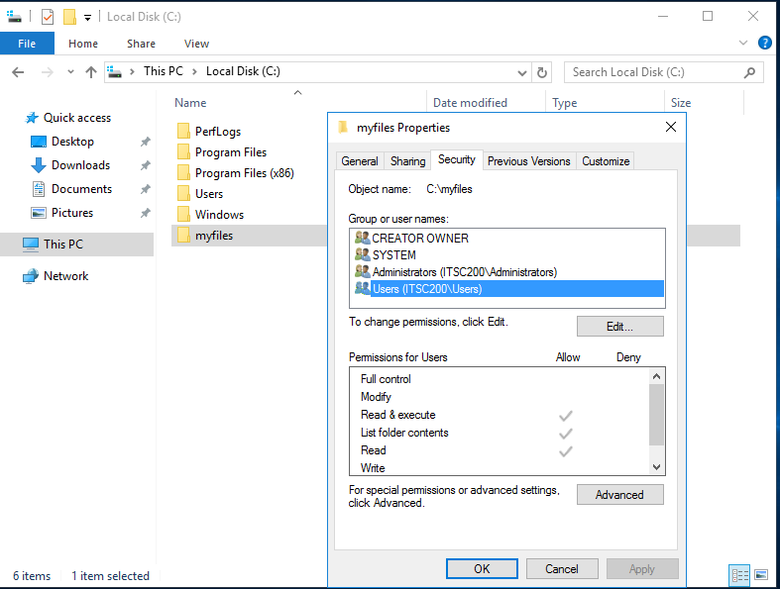
Windows NTFS

Slide 9
Windows NTFS
You can see the NTFS permissions in the previous slide, however there is one permission not visible because of the side sliding bar. That permission is “special permissions”.
“Special permissions” allow the administrator to apply very “fine-grained” permissions.

Slide 10
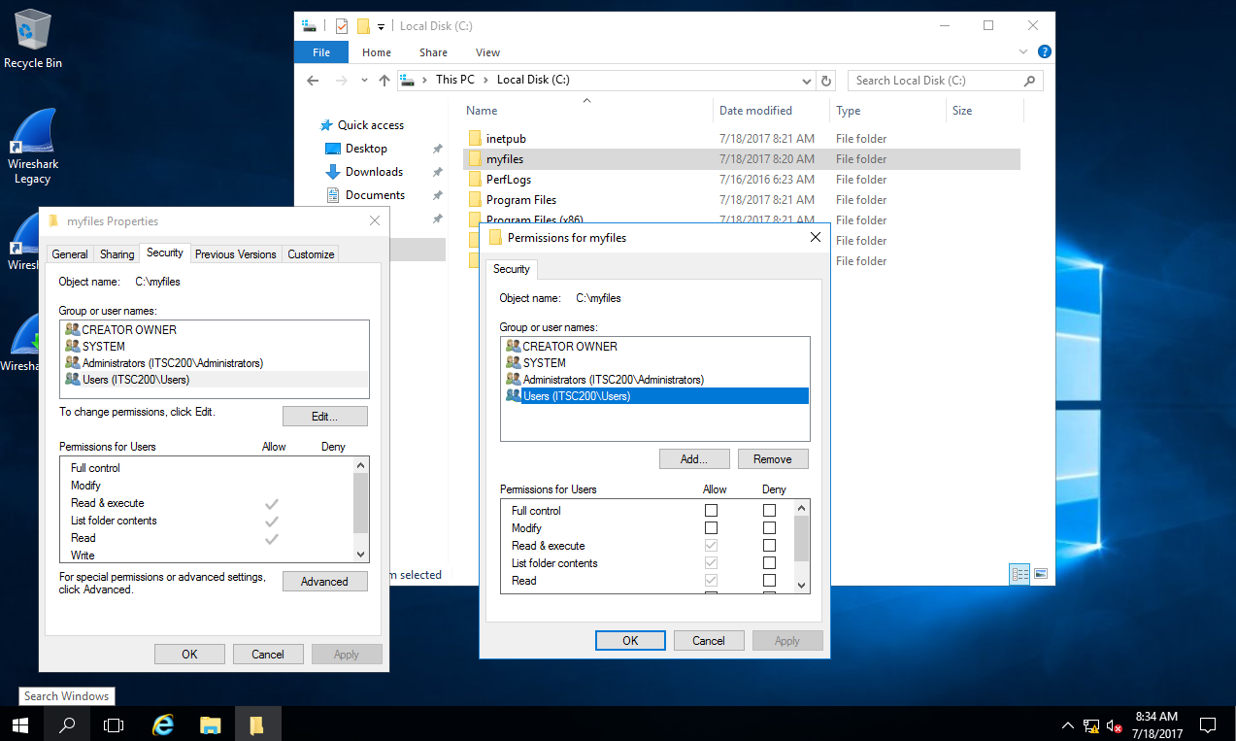
Windows NTFS

Slide 11
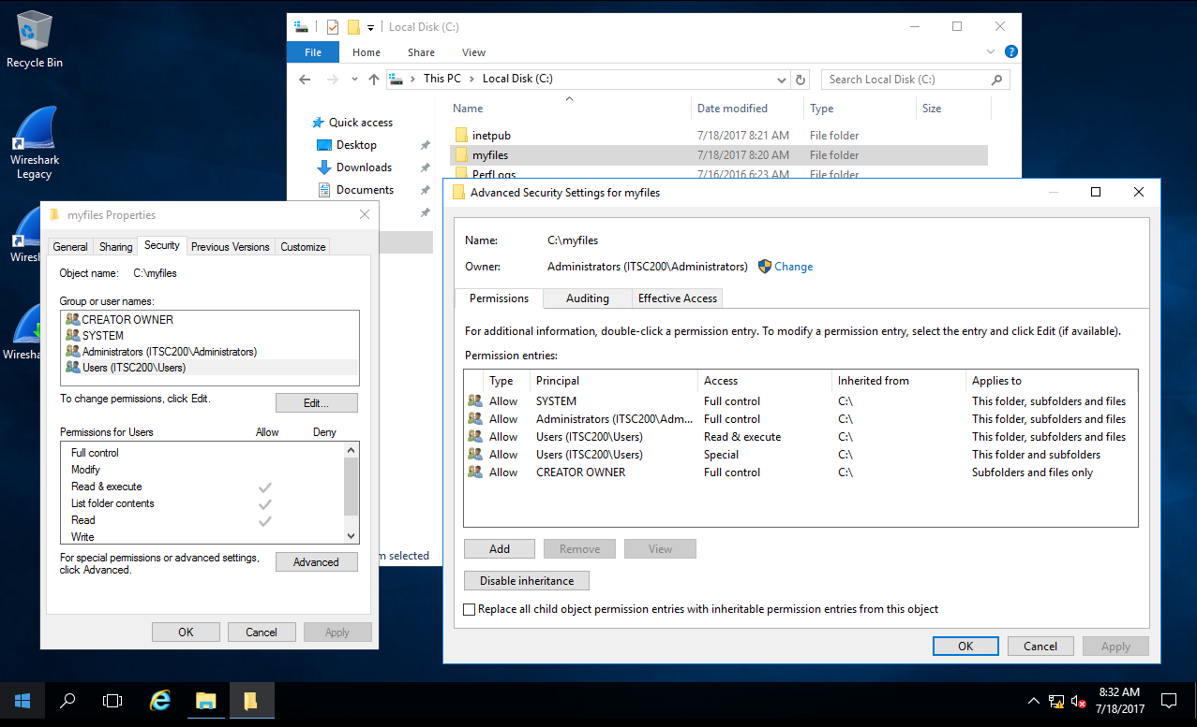
Windows NTFS (Advanced Security)

Slide 12
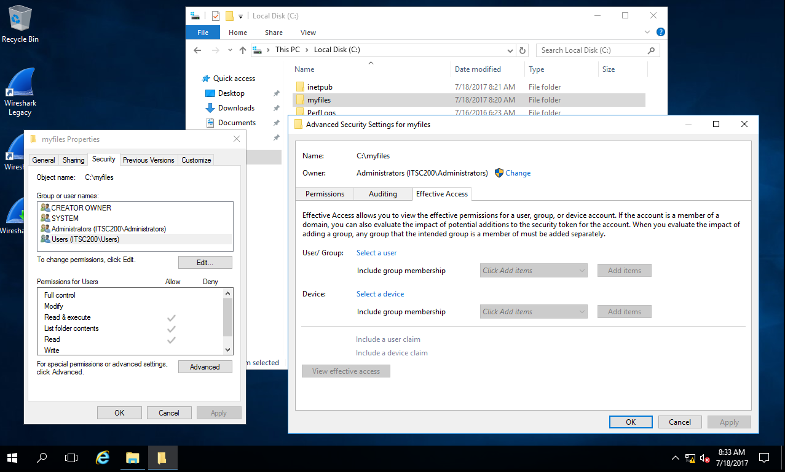
Windows NTFS (Advanced Security)

Slide 13
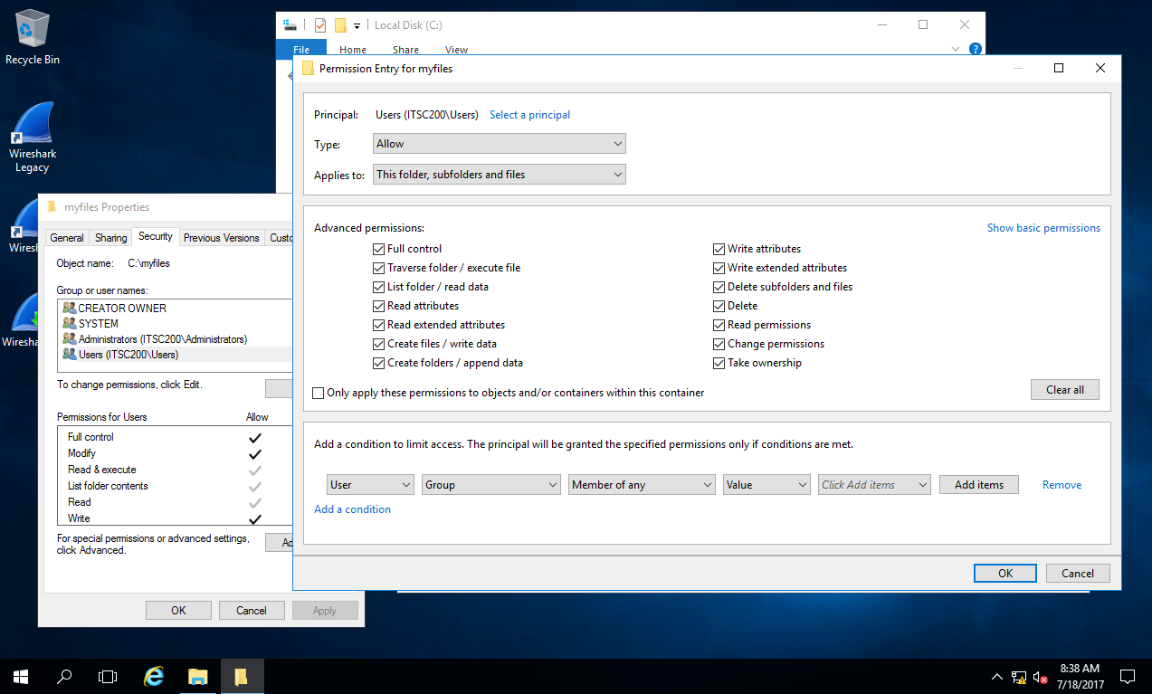
Windows NTFS (Advanced Security)

Slide 14
Windows NTFS Auditing
The NTFS file system has the ability to audit file and directory access.
Auditing must be enabled at the operating system level before file/directory auditing will take place regardless of whether or not auditing is set up on the file system.
Attemped access (failure) can be audited as well as actual access (success).

Slide 15
Windows NTFS Auditing
It is generally considered good practice to audit failure rather than success.
It should be noted that shared printers can be audited as well.
Once auditing is enabled at the OS level, events (like logins, etc.) can be audited as well.

Slide 16
Windows Share Permissions
Windows provides access to disk resources by creating “shares”.
This feature in Windows is very old, actually pre-dating Windows itself. It first showed up in Microsoft Lan Manager in the early 1990’s.
MS Lan Manager was network sharing software that was jointly developed by IBM (they called their version “Lan Server”) and Microsoft to share disk resources (“shares”)
IBM installed it on top of OS/2 and Microsoft installed it on top of OS/2 or UNIX … yes, you read that correctly.
It works pretty much the same as it did then and that also explains the references to “Lanman” that you may see in Windows occasionally.

Slide 17
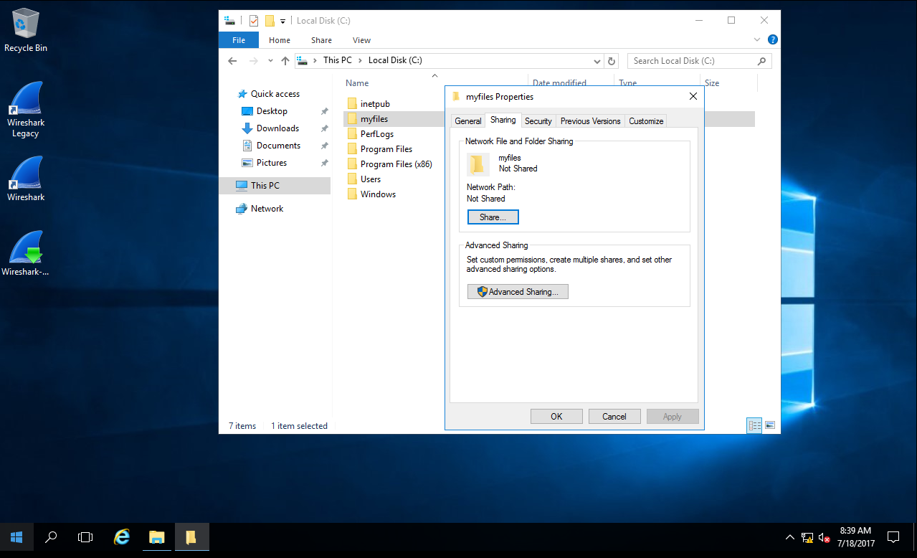
Windows Share Permissions

Slide 18
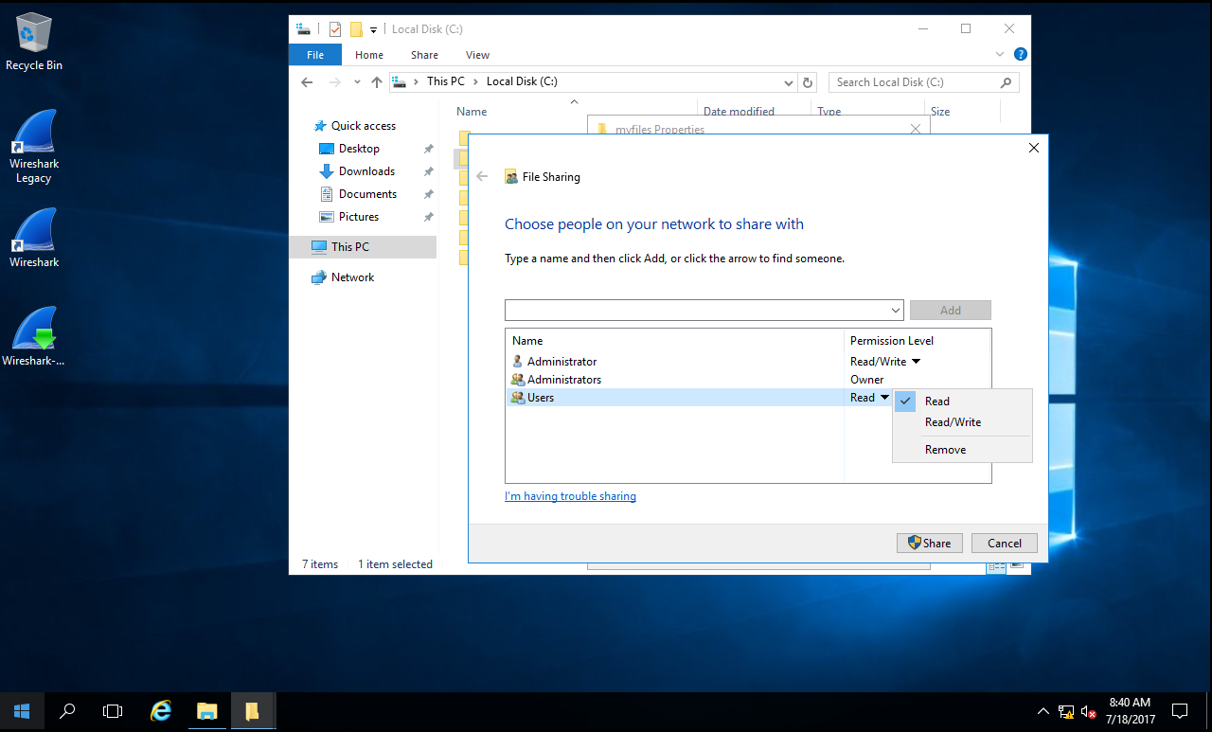
Windows Share Permissions

Slide 19
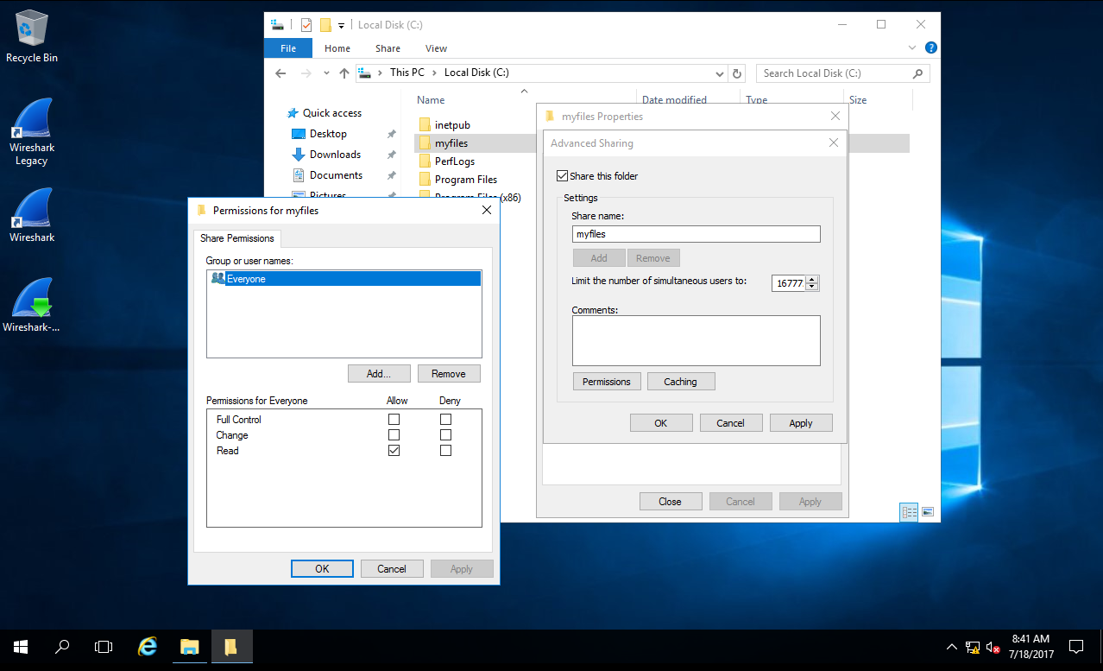
Windows Share Permissions

Slide 20

Coffee Break!

Slide 21
Connecting to Shares
Once a share is created, we can connect from a workstation (or another server).
We need to have permission (we need both NTFS and share permissions).
Shares can be created on workstations, even if they are only in a workgroup.

Slide 22
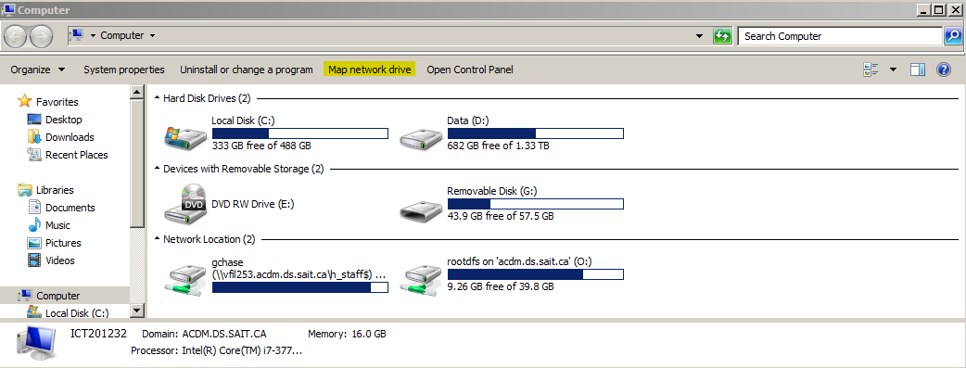
Connecting to Shares

Slide 23
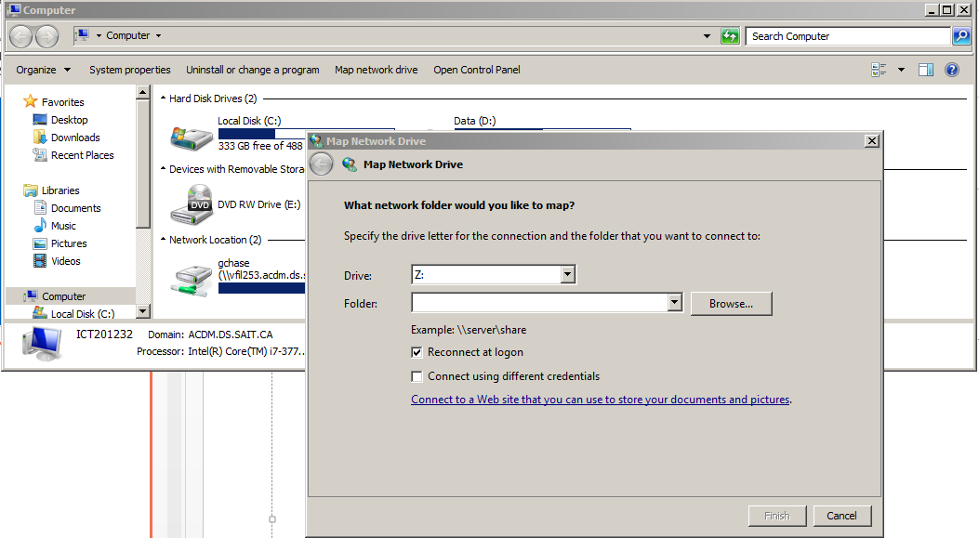
Connecting to Shares

Slide 24
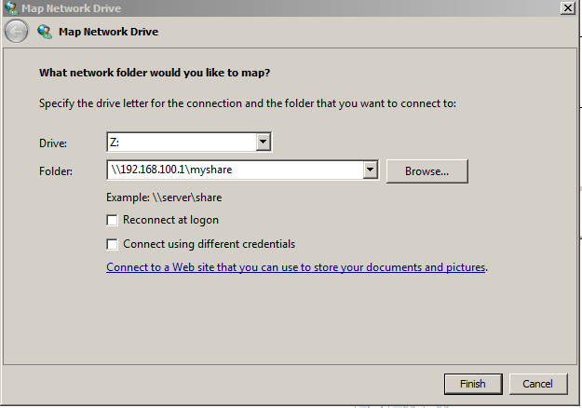
Connecting to Shares

Slide 25
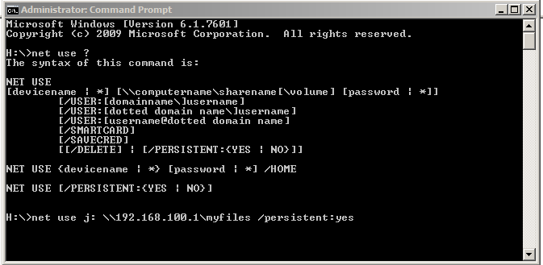
Connecting to Shares

Slide 26
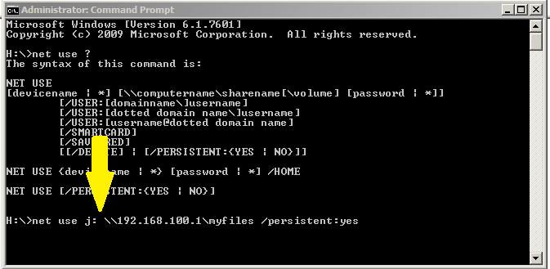
Connecting to Shares
You must have a space between the drive letter and the path.

Slide 27
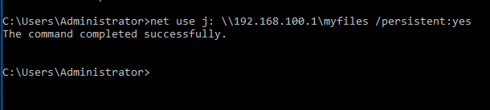
Connecting to Shares

Slide 28
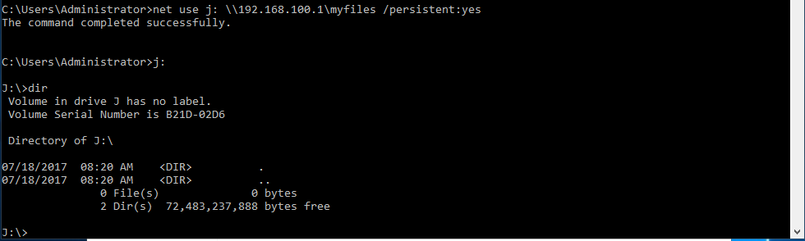
Connecting to Shares

Slide 29
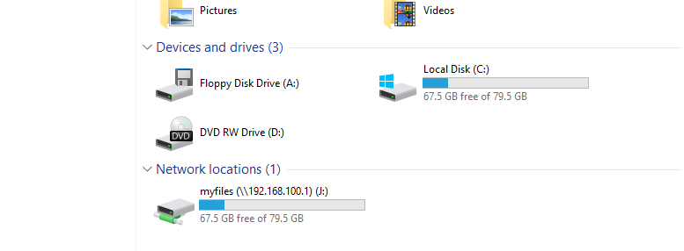
Connecting to Shares

Slide 30
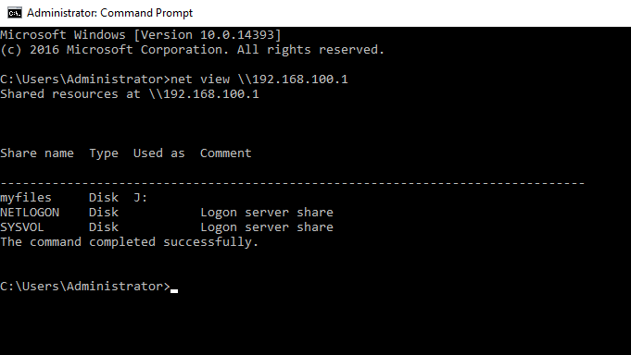
Finding Shares

Slide 31
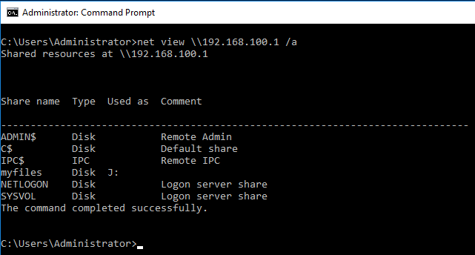
Finding Shares

Slide 32
Server Message Block
SMB can run on top of the session (and lower) network layers in several ways:
Directly over TCP, port 445
Via the NetBIOS API, which in turn can run on several transports
On UDP ports 137, 138 & TCP ports 137, 139 (NetBIOS over TCP/IP)

Slide 33
Server Message Block
NetBIOS over TCP traditionally uses the following ports:
nbname 137/UDP
nbname 137/TCP
nbdatagram 138/UDP
nbsession 139/TCP
Direct hosted "NetBIOS-less" SMB traffic (newer) uses port 445 (TCP and UDP).
In this situation, a four-byte header precedes the SMB traffic. The first byte of this header is always 0x00, and the next three bytes are the length of the remaining data.

Slide 34
Lab 9
Download and complete lab9.docx
Download smb_myhomedir.pcapng

Slide 35
Done

